Slide 1

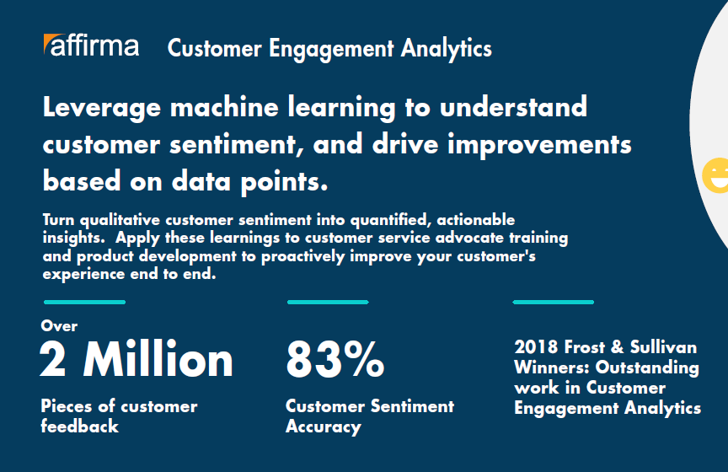
Microsoft – Voice of the Customer Implementation
Business Need
Microsoft came to Affirma looking for support in their Voice of the Customer initiative. The goal was to capture qualitative customer sentiment and turn it into quantifiable, actionable insights.
Ongoing Partnership
Affirma established a team of 10 resources including Project Management, Architects and Software Engineers
The team developed a solution leveraging Azure Machine Learning, Power BI and custom development.
The solution aggregates customer sentiment across chat data, survey verbatims, social media, and other data sources.
These insights are proactively applied across the business including; customer advocate training, product development, survey experiences and more.
Affirma’s team continues to provide ongoing enhancements to the solution and business support for reporting and analysis.

